Slide 1
Jisc Data and visualisation services: Overview 2018

Slide 2

What we are doing
We have worked with partners to create a business intelligence shared service for UK education
Launched 2016, currently free to use, charging from Q2 2018
  More info at :
    https://www.jisc.ac.uk/rd/projects/business-intelligence-project
    https://business-intelligence.ac.uk/

Slide 3
More specifically
Analytics Labs – proven, innovative and unique approach
  Co-created using the imagination and expertise of a wide range of participants
  Identifies timely areas of wide applicability to UK education (Student, Workforce, Staffing, Estates etc)
  Upskills the workforce / CPD (competency framework)
Community Dashboards
  Creates rapid prototypes of data flows and interactive dashboards which move to production as prioritised
  Generates feedback on the data leading to data enhancement and new data
  We can get what is good and what works into production rapidly on our robust infrastructure (including tech and legal frameworks)

Slide 4
A Jisc / HESA collaboration
Analytics Labs and Community Dashboards are enabling participating members to:
Access and analyse a growing portfolio of quality assured data dashboards
Review comparative data from quality sources
Compare their own performance with that of peer organisations
Identify new trends and gain fresh insights
Plan for future scenarios and assess risk

Slide 5
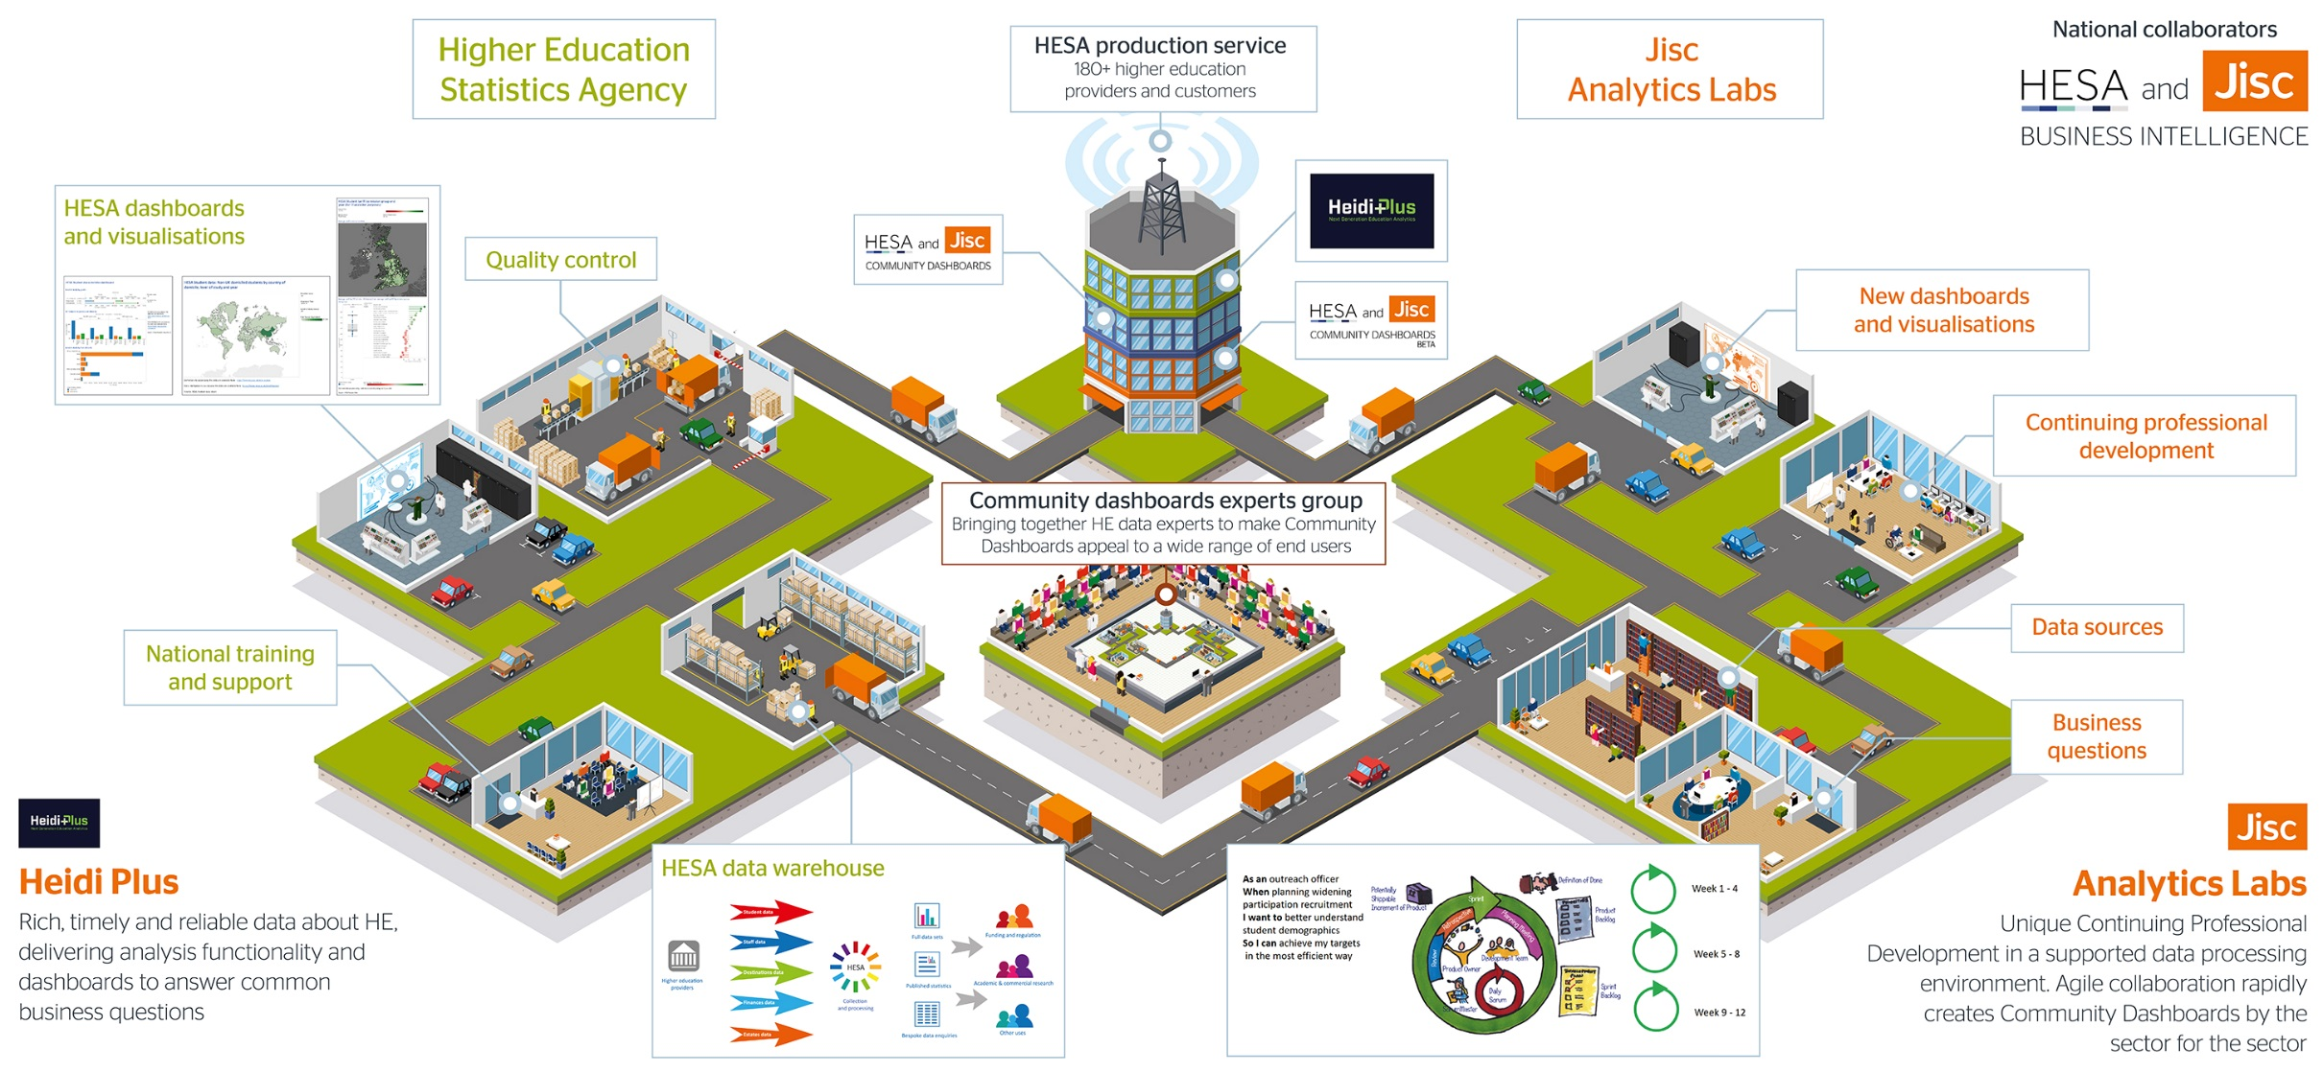
Notes:
Myles
Mention the governance and the theme identification and allocation
Heidi Plus is depicted on the left – highlight the trucks driving in to the HESA data warehouse. HESA mandates that all publicly funded HEPs provide performance data on students, destinations of leavers, staff, finance and estates. Currently an annual collection they are moving to more frequent in year collections. The data is cleansed and a new team undertake dashboard development. Quality is assured as the dashboards are offered throught the radio mast in the middle – a new national BI dashboard delivery service offered to all HESA customers (currently 180 HEPs and associated organisations and departments). Built with Jisc and launched as a HESA service in November. Includes legal framework and national training programme. Replaces a system with 6.5K users. Lowers the bar to usage through the interactive dashboards so could take BI to a woder range of staff than is currently possible.
Heidi Lab is depicted to the right. A Jisc led alpha July 15 – July 16. Highlight the trucks again and note it’s a two way street – a data sharing agreement allows HESA data into the Heidi Lab secure data processing environment. Agile analysis teams are created from multiple universities and given access. They identify commonly felt problems spaces, explore the wider national data landscape, acquire non-HESA data and cleanse, link and transform it creating new proof of concept dashboards. Highlight the trucksa driving from the Lab to the Radio Mast. Successful dashboards will be branbded produced by Jisc and delivered via Heidi Plus.
Piece in the middle is the beta service – what comes next – Heidi Plus is sustained by HESA as a service. We have proved there is real merit in Heidi Labs and will launch a beta service July 16 – July 17.

Slide 6
People and data
Wide network of partners
  Key interest groups: Association of Directors of Estates, British Universities Finance Group, Equality Challenge Unit, Higher Education Academy, Higher Education Strategic Planners Association, SCONUL, Universities Human Resources, Universities and Colleges Employers Association
  Other agencies and bodies: Quality Assurance Agency, Department for Education, Guild HE, Office of National Statistics, Research Councils UK (RCUK), the Higher Education Funding Council for England (HEFCE), Prospects / HECSU, Universities and Colleges Admissions Service (UCAS), Universities UK
Combining data sources
  57 data sets explored and catalogued e.g. LMI for all, LEO, ONS, ILR, Working Futures, Employer Skills Survey
Exploring themes
  62 unique areas, 9 themes (course, finance, benchmarking, research, resourcing/finance, staffing, students (includes social mobility and transition/progression), estates, library

Slide 7
Why this way
Data landscape is very fragmented - this helps us makes sense of the landscape on a national basis
We can do it once and well for all HEIs creating a shared infrastructure
Enhances strategic planning and decision making
Reduces the current massive duplication of effort, improves effectiveness, achieves efficiencies and saves resources
The start of this journey, all the time we are discovering new insights that could not have been anticipated previously and related benefits

Slide 8

Community Dashboards – what’s available now?
Notes:
Myles

Slide 9
Community Dashboards Released
December 16 dashboard release (total 4)
available to use now
ID | Name | Release Date
1 | Athena Swan & Race Equality Dashboard | Dec 16
2 | Destination of Leavers by Activity | Dec 16
3 | Destination of Leavers Explorer | Dec 16
4 | HE-BCI Part B Explorer | Dec 16
5 | University Research Benchmarking | Feb 18
6 | Finding Comparable Providers | Sep 17
7 | League Table Dashboard | Jan 18
9 | School Finder | Sep 17
11 | Single HEI Comparison by FTE | Sep 17
12 | Destination Flow | Sep 17
22 | A-Level Subjects | Feb 18
25 | Costs vs Staff Correlation | Feb 18
29 | Brexit Implications on Research | Jan 18
31 | Estates Sector Benchmarks | Jan 18
39 | Provider Healthcheck | Feb 18

Slide 10
Focus on - League Table Dashboard
In January 2018 we reached an agreement with the Guardian and the Times/Sunday Times newspapers and published interactive dashboards of rankings and measures drawn from their HE league tables.
Until this point universities had to compile the data manually and undertake their own analysis, hampered by the fact that the league tables use different criteria and weightings.
Published as part of the Community Dashboards initiative, these new dashboards were accessed over 600 times in the first seven days.

Slide 11
What is
Analytics Labs?
Notes:
Myles 5 mins

Slide 12
What is Analytics Labs?
Analytics Labs is a unique Continuing Professional Development opportunity for participants from across the UK HE sector offered in a supported data processing environment.
Teams with a range of expertise in data and visualisation work together with sector colleagues with an in-depth knowledge of the policy context.
This Agile collaboration rapidly creates proof of concept dashboards. Some are selected to be further developed and released as ‘Community Dashboards by the sector for the sector...’
246 participants from 95 UK Universities so far…

Slide 13
Makeup of a team
Product Owner
Brings an understanding of the policy context and the needs of users
Analysts
Expertise in data and analysis, especially from a HEI perspective
Data Wranglers
Supports the team with specialist knowledge in tools such as Alteryx and Tableau
Scrum Master
Keeps the project on track and removes impediments to progress

Slide 14

246 people from 95
Universities participated to date

Slide 15

Digital Badge
On completion of the Analytics Labs all team members will be offered a digital badge.

Slide 16
Five competencies
The badge records your participation in Analytics Labs and your Continuing Professional Development (CPD) against 5 competencies.
      Participating in agile development
      Visualising data
      Transforming data
      Understanding policy and the data landscape
      Digital collaboration

Slide 17
Exploration topic coverage Heat Map
Course Management | WP | Benchmarking | Equality | Destinations
Post Graduate | Library | TEF | Marketing | RAE
Student Experience | Brexit | Estates | Accommodation | PGT
PGR | Course Development | Retention | Student Journey | Course Articulation
Library Usage | QA | Value Added | Course Offering | Planning

Slide 18
Heat map explanation
The most covered area was Library because we have run a dedicated lab for libraries and have had library teams in other cycles.
Most of the user stories were in the student general area, the categories were used to break that down.
These areas and categories are the first attempt at doing this.
A new set of categories and areas is under development which will be taken forward by a bigger team to create a taxonomy allowing search and discover across the portfolio

Slide 19
Some User Stories from previous teams
Notes:
Kris

Slide 20
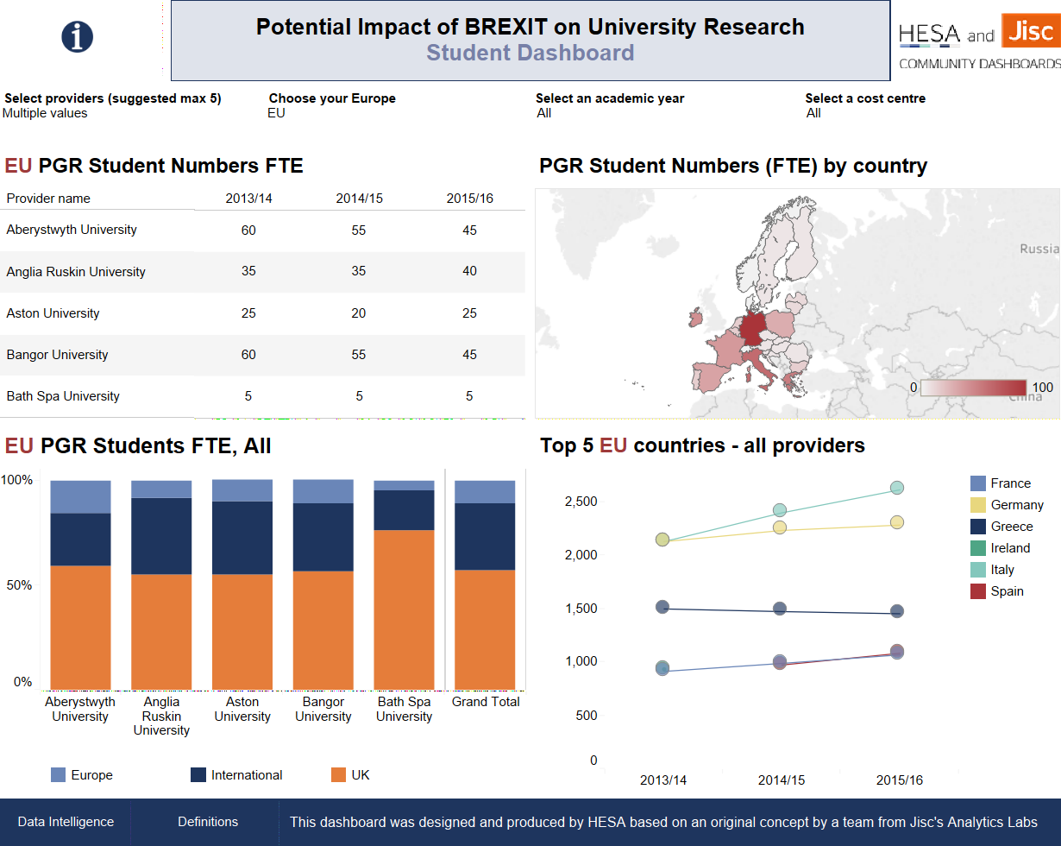
Potential Impact of Brexit on Research
Notes:
Not priority for demo

Slide 21
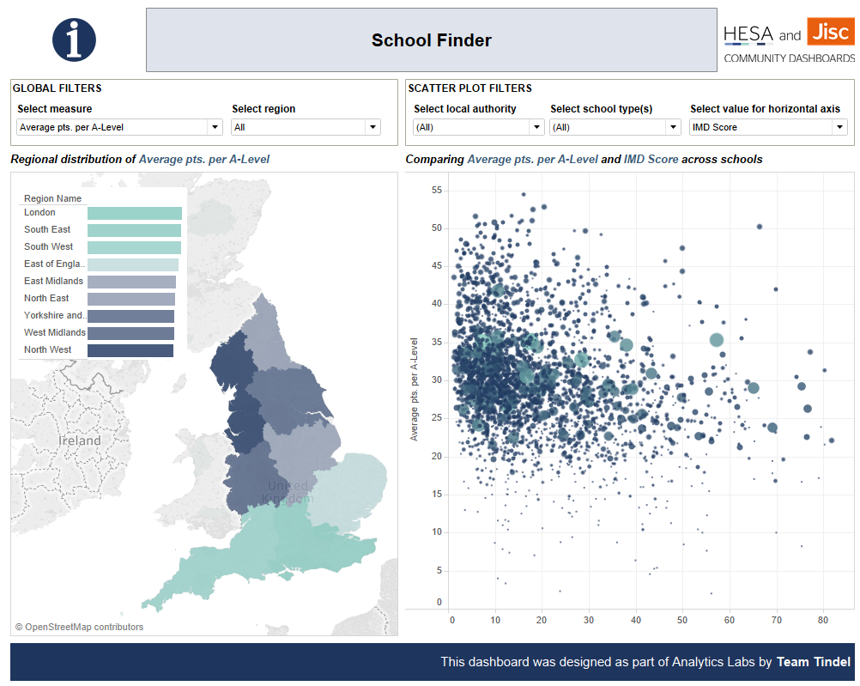
Widening Participation (Inclusion)
As a WP Practitioner/School Outreach Activity Officer
When deciding to allocate resources on outreach activity
I want to Identify areas/schools in which to concentrate outreach activities
So I can ultimately, increase recruitment from selected areas/schools and improve social mobility
Notes:
Kris

Slide 22
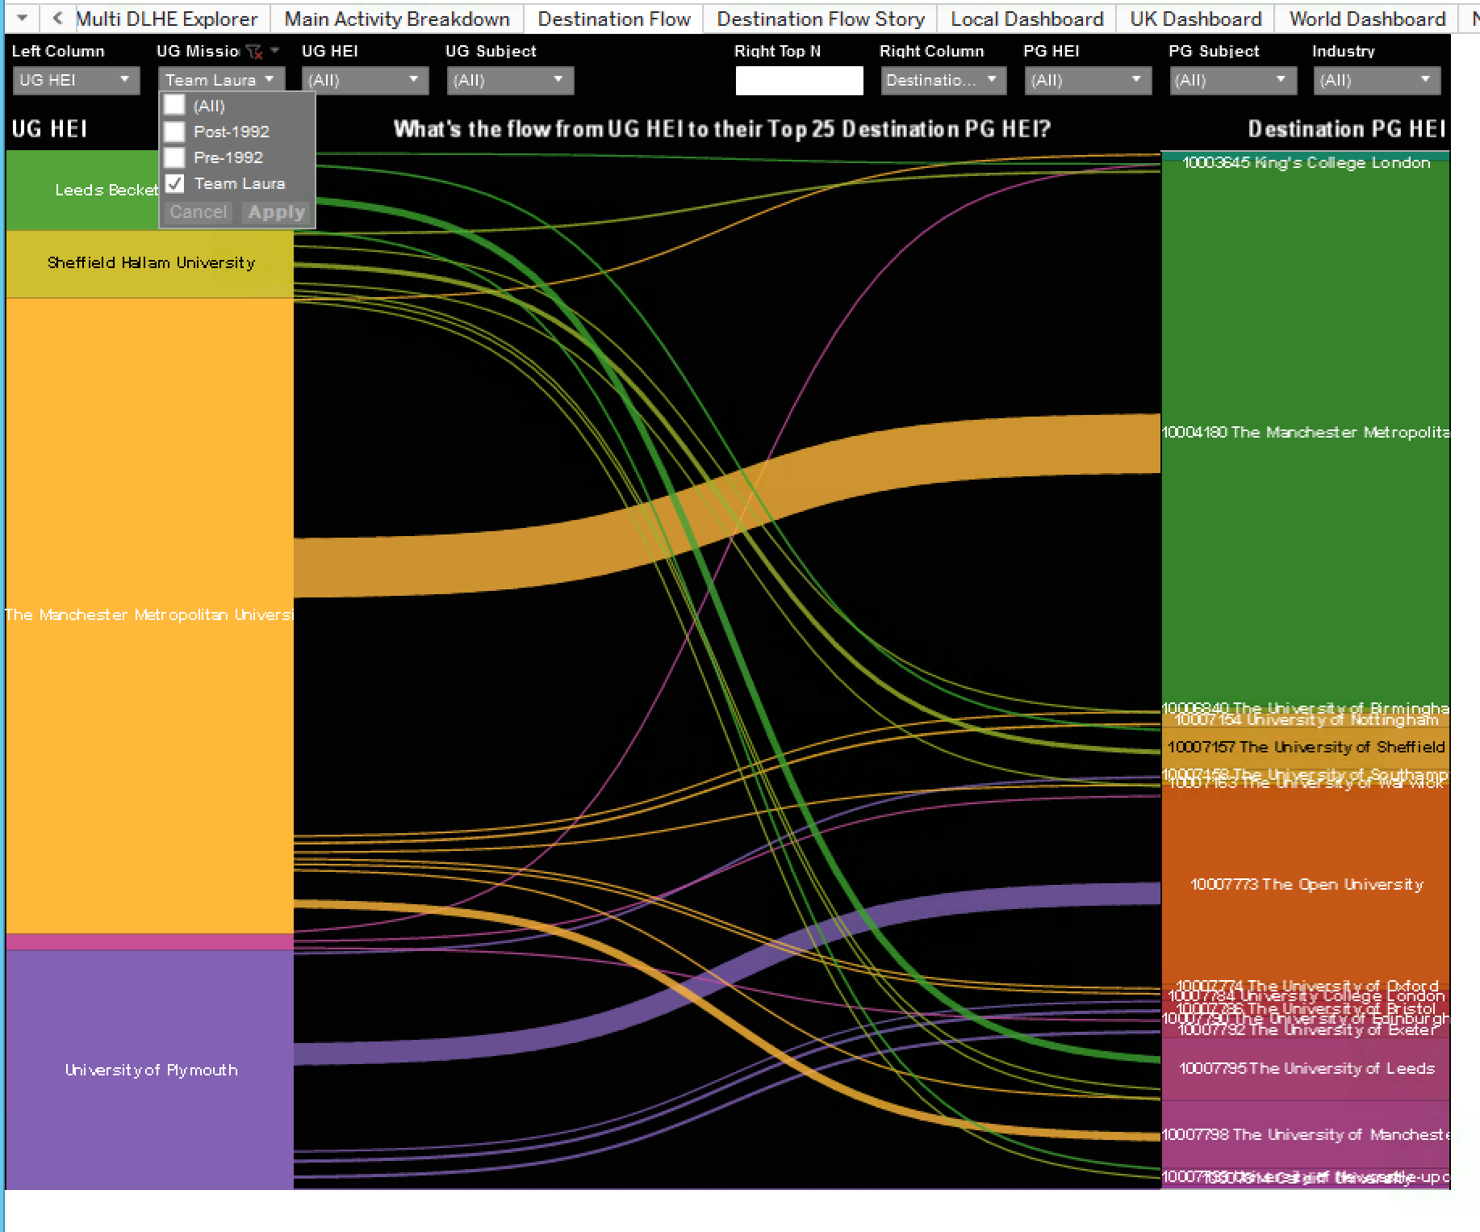
Where do my students go post graduation?
I want to understand the destinations of my students post graduation (in particular further study and employment) so that I can ensure the credibility and sustainability of our curriculum and optimise income
Notes:
Scott

Slide 23
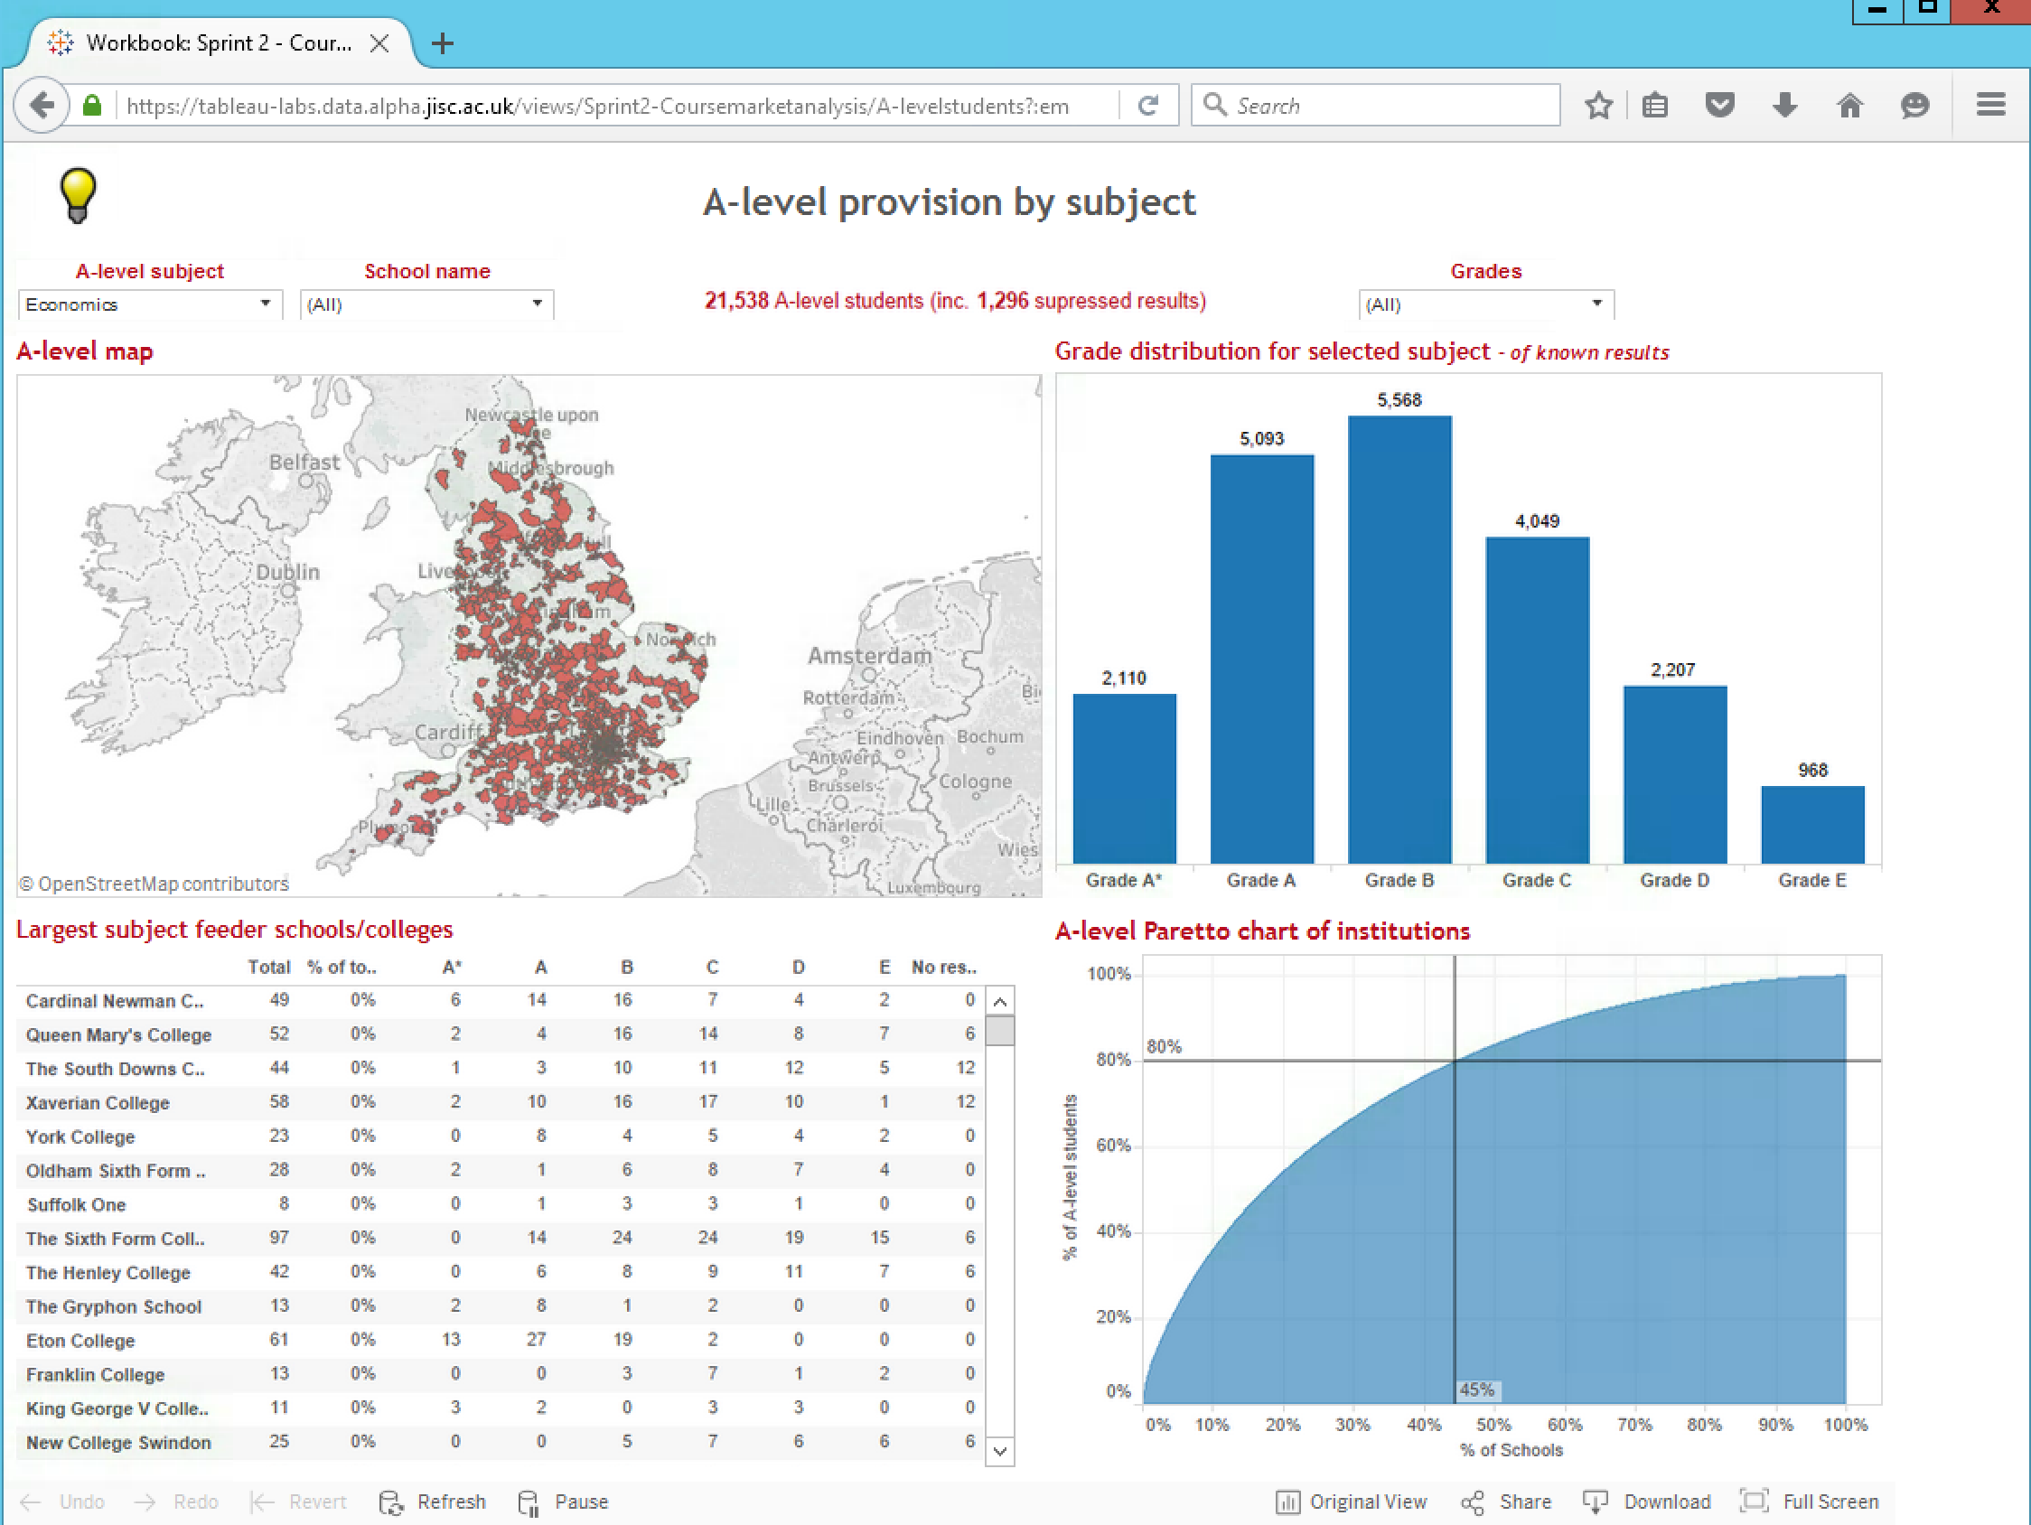
Cycle 1: Course Market Analysis (Course Development)
As a Strategic planner
When working out which courses to teach
I want to examine competition to my course offerings
To ensure I target recruitment activity most effectively saving money on marketing and making money by retention
Notes:
Kris

Slide 24
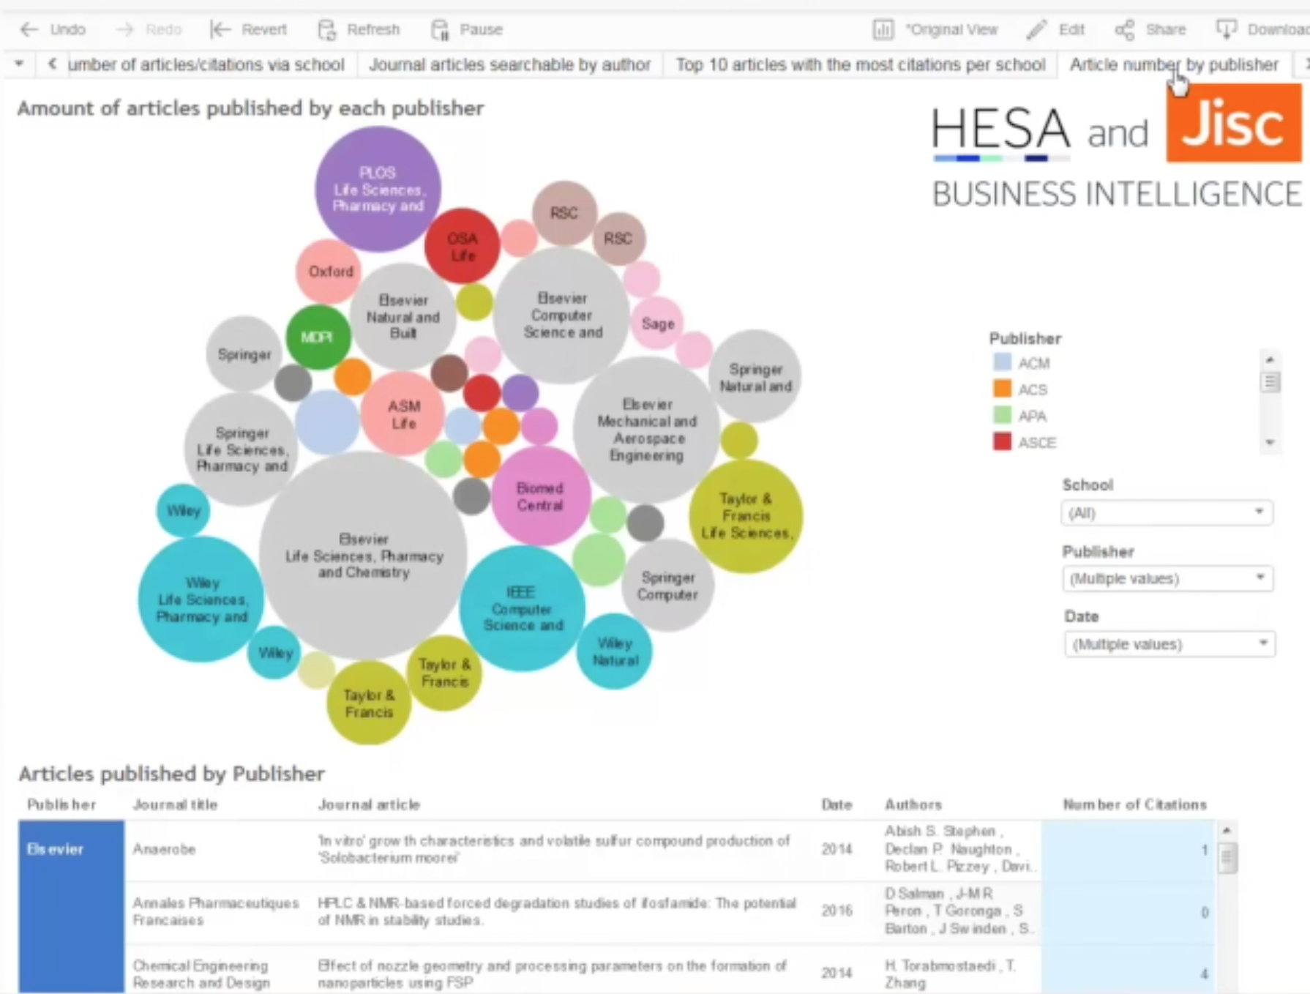
REF and Staff Publications (Research)
When I am assessing research performance I want to assess University, discipline and individual citation performance so I can measure progress against citation KPIs and REF aspirations
Notes:
Kris

Slide 25
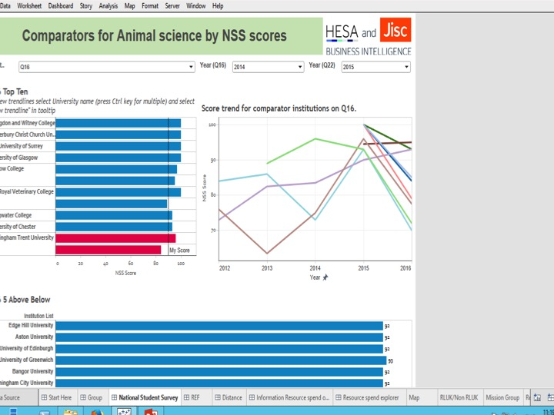
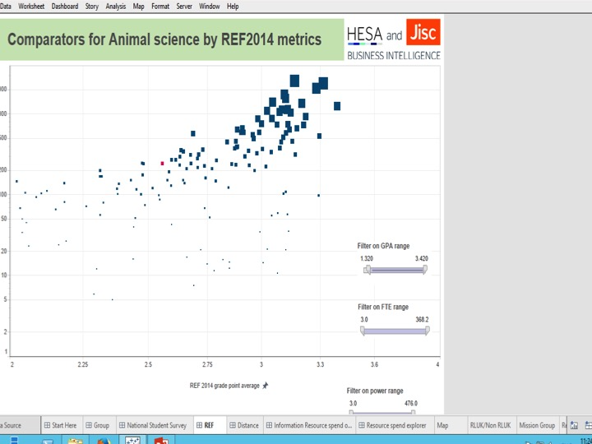
Library comparison by… (Resourcing and Benchmarking)
As a library director
When working on the annual budget bidding process
I want to compare my library’s spend on a given subject with the corresponding spend by my institution; with comparator institutions and comparator institution’s libraries
So that I can assess the performance and value for money of my services
Notes:
Scott

Slide 26
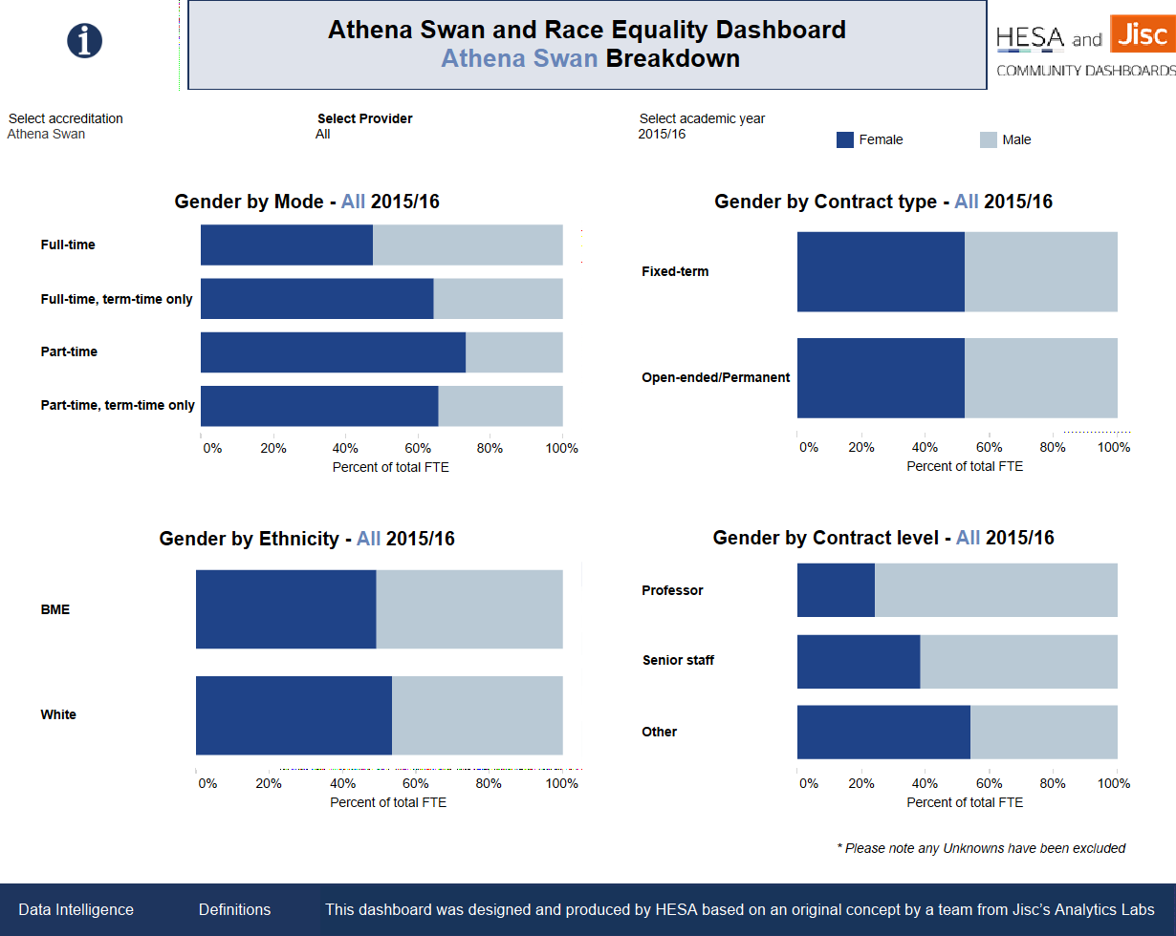
Athena Swan & Race Equality
Notes:
Quick look

Slide 27
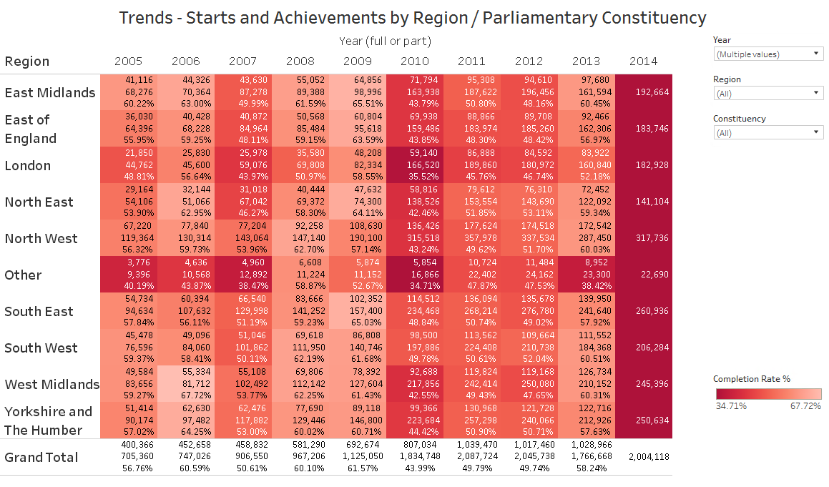
Early look at HE Apprenticeships
Notes:
2 minute presentation

Slide 28
Teams and Themes for proof of concept generation November 2017 – February 2018
Notes:
Myles

Slide 29
Teams and Themes November 17 – February 2018
Possible career paths
  As a Planning Officer/Prospective Student, I want to understand the current range of available courses and what the demand is for these among prospective students so that I can offer the most attractive portfolio of courses OR select a course/HEI which matches my ambitions (if I am a prospective student
  As a university planning officer I want to understand the gap between future jobs and current education provision so that I might update my portfolio accordingly

Slide 30
Teams and Themes November 17 – February 2018
2. UHR/UCEA. The bigger picture of Human Resources and its impact on student outcomes
    As a DV-C/Pro V-C/HR Director, when undertaking periodic HR reviews, I want to understand the sickness and absence at my institution compared to other institutions, so that I can provide continuity and quality of teaching for students to ensure good student outcomes.
    As a Faculty Lead/HR Director, when recruiting academic staff I want to understand the likely career journey of an academic inside and outside of HE, so I can recruit and retain talented staff and predict likely movement/career span of staff
    As a HR analyst, when looking at factors affecting sickness, I want to be able to determine the statistical validity of correlations between absence and various other factors, so that I can more effectively focus further effort in analytics

Slide 31
Teams and Themes November 17 – February 2018
3. TEF 2 analysis tool
    As a: Exec member/Senior Manager. When: influencing/compiling TEF submission. I want to: bring together contextual information from TEF submissions (Gold maybe) and compare with metric performance. So I can: Understand best practice, add value to my TEF submission and influence metric performance in the long term
    AS A: senior user WHEN: reviewing resource planning TEF I WANT TO: understand the impact of staff makeup on TEF performance SO THAT: Better target resource investment
    AS A: Exec Member WHEN: Developing actions to improves Subject Flags I WANT TO: See what effect improving in an area has on Flags SO THAT: I can make a decision of an area to focus o

Slide 32
Teams and Themes November 17 – February 2018
4. Current and future recruitment time series and Geo mobility
    As a marketing and recruitment department. When formulating our recruitment and marketing strategy at local, national and international level. I want to understand the geographic mobility and structural factors affecting recruitment of prospective students, and retention and progression of students. This includes primary factors such as travel times and term-time accommodation, also analysed by secondary factors such as gender and entry tariff. I also want to see the impact of these factors over time and over the pipeline of recruitment to progression to better understand longitudinal impact. I also want to get a better idea of how neighboring institutions may be competing within the same geographic area.

Slide 33
Teams and Themes November 17 – February 2018
4. Current and future recruitment time series and Geo mobility
    I would like to have a picture of the percentages of students living in less connected areas (PTAL) and the relationship with their drop out rates. It would be interesting to be able to compare this information by Term Time Accomodation codes
    As a: Dean I want to: Be able to determine the causes of students dropping out By: ascertaining whether areas with poor transport links drive a higher propensity to drop out So that: I can work with local authorities on transport arrangements or with estates re accommodation plans

Slide 34
Teams and Themes for proof of concept generation starting 7 February 2018
Notes:
Myles

Slide 35
Teams and Themes starting 7 February 2018
Five teams covering
  Opportunities to enhance PG experience with a focus on Admissions
  A Level/equivalent take-up trends and applicant quality
  BME filter on value added – differential value-added qualification outcomes
  An analytical exploration into time series trend of degree classifications awarded with emphasis on recent claims of grade inflation versus other possible explanations.
  Alternative Higher Education Providers

Slide 36
Theme: Opportunities to enhance Postgraduate (PG) experience with a focus on Admissions
  Current situation identified re PG Admissions – there is a lot of information available for undergraduates (UGs) but not on PGs.
  Why does this matter?
    VCs / Senior Management are often making PG decisions in a vacuum.
    Admissions find planning for load harder.
    Maximising intake is difficult.
    Early intervention for problem scenarios is difficult - Collapse in markets - Course attractiveness - Local vs global.
  What would we like:
    Simple in-cycle information sharing about applications and offers.
    Spreadsheet upload.
    Graphs / tables for analysis.
    Local vs National position.
  In an ideal world: Fee status breakdown (Home, EU, Overseas). Competitor basket comparison. Subject area grouping.

Slide 37
Theme: Opportunities to enhance Postgraduate (PG) experience with a focus on Admissions
  Strategic Advisory Group Champion – Shabana Akhtar
    With expert input from Marcus Phillips (Sheffield)
  User stories:
    As a: Departmental / Admissions Manager.
    When: Assessing recruitment and admissions position and actions
    I want to: Know whether the patterns I see are similar for similar organisations / competitors
    So I can: Better predict load and understand which aspects may be under or beyond University control as well as assess the outcome of changes to practice / policies.
    As a: University / Faculty Senior Manager.
    When: Predicting future intake / income and deciding strategy
    I want to: Know how my institution's experience compares to the wider sector.
    So I can: See which trends are local and which national / international and therefore better predict the intake and income to the institution and decide on appropriate future strategies.
  Data:
    Russell Group PG Admissions Group, HESA: Student Other: UCAS, PTES, PRES, Research Grants.
    Team to identify any gaps in the data collected.
    Potential for new institutional data collection required (however for these purposes team’s efforts should be focussed on proof of concept dashboards)

Slide 38
Theme: Opportunities to enhance Postgraduate (PG) experience with a focus on Admissions
  Strategic Advisory Group Champion – Shabana Akhtar
    With expert input from Marcus Phillips (Sheffield)
  User stories – to be developed.
    Marcus Phillips is well placed to know the data that would be needed to satisfy the need and the key areas the sector would be interested in knowing about.
  Data:
    Russell Group PG Admissions Group, HESA: Student Other: UCAS, PTES, PRES, Research Grants.
    Team to identify any gaps in the data collected.
    Potential for new institutional data collection required (however for these purposes team’s efforts should be focussed on proof of concept dashboards)

Slide 39
Theme: A Level/equivalent take-up trends and applicant quality
A level subjects - map to university applications by subject. School leavers qualifications.
  A ‘public data’ explorer, could also get data from HESA student record (tariff score).
Strategic Advisory Group Champion – James Jackson
Data sources:
  HESA has a wide range of data to support this theme, including Student record and tariff score.
  Other: UCAS, DfE.

Slide 40
Theme: A Level/equivalent take-up trends and applicant quality
User story 1:
  As a: Faculty / School / Programme Manager.
  When: assessing which A-level / equivalent subjects to offer.
  I want to: know which subjects are pre-requisites for university admission.
  So I can: understand the viability of our offering
  Data sources for this user story: Edubase, DfE (A-level attainment), UCAS.
User story 2:
  As a: Recruiter/Programme Manager.
  When: formulating our recruitment & marketing strategy.
  I want to: understand which A-level (equivalent) subjects are on offer in secondary schools (and the quality of attainment) of potential applicants.
  So I can: assess the pipeline and influence our recruitment strategy.
  Data sources for this user story: Edubase, DfE, ScotGov, HESA, UCAS.

Slide 41
Theme: BME filter on value added – differential value-added qualification outcomes
Very complex, many variables. HEFCE have done a lot of work in this area. Differential outcomes and value added.
  Would be enhanced by adding Widening Participation indicators such as IMD, Prior parental education & SEC.
  Potential to load into Learning Analytics Apps.
Suggested approach:
  Look at degree outcomes by entry qualifications. This would save HEIs trying to recreate the Guardian value-added score, then break down by further characteristics like BAME and WP indicators etc.
  BAME as the primary characteristic and ability to assess at TEF subject level (as TEF is also collecting degree outcomes data over 10 years, but NOT currently contextualized by entry qualifications).

Slide 42
Theme: BME filter on value added – differential value-added qualification outcomes
  Strategic Advisory Group Champion – Julie Leeming
    Additional expertise from Rebecca Finlayson of HEFCE
    Also interest from Equality Challenge Unit
  User story 1
    As a Senior Manager
    When assessing degree outcomes
    I want to monitor results of students from all backgrounds
    So I can be confident that all students are enabled to achieve a good degree classification
  User story 2
    As a Director of Planning
    I want to be able to monitor value-added outcomes over time
    So I can assess if the BAME attainment gap is closing
  Data sources: can come entirely from HESA for value-added by BAME (and by subject)

Slide 43
Theme: An analytical exploration into time series trend of degree classifications awarded with emphasis on recent claims of grade inflation versus other possible explanations
  Grade Inflation/Grade Improvement.
  There is much debate in the media and in the UK Government about perceptions and suggestions of Grade Inflation in the sector.
  Some in the sector prefer to discuss the concept of Grade Improvement instead.
  Academic standards are becoming more regulated and this is a hot policy topic.
  Debate about given prior entry qualifications, academic achievement beyond what would (all things being equal) be learning gain and value added.

Slide 44
Theme: An analytical exploration into time series trend of degree classifications awarded with emphasis on recent claims of grade inflation versus other possible explanations
  Strategic Advisory Group Champion – Laura Knox
  User story:
    As a planning officer.
    When monitoring and responding to suggestions of grade inflation.
    I want to create and use robust algorithms for evidencing and understanding grade inflation/grade improvement.
      Potentially creating institution benchmarks which would take into account the profile, subject mix, demographic of an institution to make the judgement fairer.
    So I can: Evidence the true rationale for perceived grade inflation.
  The aim would be to demonstrate the factors that could result in grade inflation or perhaps grade improvement (i.e. an increase in entry standards over the years) etc.
  Data sources: HESA: Student, DLHE Other: UCAS tariff. Learning Analytics pilot?
Notes:
Scott

Slide 45
Teams and Themes for proof of concept generation May 2018 – August2018
Notes:
Myles

Slide 46
Teams and Themes May 18 – August 2018
1. KEF
    With HEFCE KEF Technical Advisory Group
    As a PVC for Enterprise and Engagement. When: Reviewing potential strategic initiatives for knowledge exchange. I want to: be able to review current measures of activity against the sector. So I can benchmark current performance and prioritise future activity.
    With HEFCE KEF Technical advisory Group

Slide 47
Teams and Themes May 18 – August 2018
2. Student residencies, local economy and student population impact, city use, Grenfell requirements etc
    as a: strategic planner/director of estates when planning student numbers and/or accommodation. - I want to understand the impact on the local area of student accommodation and potential new build, understand the impact of student numbers on the local resident and/or workday population at present and in future (taking into account potential student number growth and forecast local population growth), on working and non-working days and in and out of term time. - so I can plan student numbers and accommodation in a sustainable fashion and collaborate effectively with local authorities and community representatives.

Slide 48
Teams and Themes May 18 – August 2018
2. Student residencies, local economy and student population impact, city use, Grenfell requirements etc
    Student numbers and accommodation. - as a: strategic planner/director of estates/etc.- when planning student numbers and/or accommodation. - I want to understand the impact on the local area of student accommodation and potential new build, understand the impact of student numbers on the local resident and/or workday population at present and in future (taking into account potential student number growth and forecast local population growth), on working and non-working days and in and out of term time. - so I can plan student numbers and accommodation in a sustainable fashion and collaborate effectively with local authorities and community representatives.

Slide 49
Teams and Themes May 18 – August 2018
2. Student residencies, local economy and student population impact, city use, Grenfell requirements etc
    Capital Investment Framework metrics and productivity as a Director of Estates. I want to understand the relation between CIF metrics, other estates data and London Economics financial analysis (on the one hand) and the NSS, learning analytics and staff engagement on the other hand.
    As a planning or HR decision-maker. when: strategically planning for the future. I want to: get better data and insight on use of space by type, and trends, and how efficiently teaching space is used, as well as to audit and validate attendance / completion /and understand how these link to learning styles and student satisfaction. so I can increase space utilization, efficiency and make sure these are taken into account when planning university student and staff growth

Slide 50
Teams and Themes May 18 – August 2018
3. REF 2021 planning
    As a REF Manager when preparing for REF I Want to track the profile of my REF-eligible population (e.g. age, gender, ECR status) over time, by UoA, and consider my research environment (e.g. PhD completion timing and behaviours); ideally looking at time series information taking me back to REF 2014, and allowing a degree of benchmarking against the sector/ subject-specific comparator groups of my choice. So I can: estimate potential performance, make decisions about recruitment and target support effectively.
    As an: Academic department head and/or REF manager When: considering research staff and outputs to submit for a given UoA in REF 2021 I want to: consider the numbers of REF-eligible staff within the current and departed academic staff population of the department/UoA and their FTE (for my own institution and across the sector) So I can: Estimate the number of excess outputs required in addition to the 1 per person in order to meet the 2.5 per person average submission requirement, and consider how the potential size of my submission compares to other institutions within that UoA.

Slide 51
Teams and Themes May 18 – August 2018
4. International Competitiveness.
  As a Director of international recruitment, when I'm developing a medium term strategy and plan for the University, I want to better understand what a strong competitive position should/could look like, and where my areas of weakness and greatest opportunity are, so I can ensure the university maintains a diverse international student profile, well into the future.
  As a Head of an academic unit, when I'm seeking to maintain (or establish) a strong global leadership position in my discipline and hold onto it well into the future, I want to know that I’m in a position to recruit and retain the highest caliber academics possible, so I can persuade and support leading academics to join the unit and help us further our aims.
  As a Vice-Chancellor, when I’m reading a news story about the policy proposals or proclamations of ministers or pundits, I want to respond quickly and confidently with facts and figures about the sector or my institution so I can better inform and influence national policy debates.

Slide 52
The Data Catalogue
Notes:
Kris

Slide 53
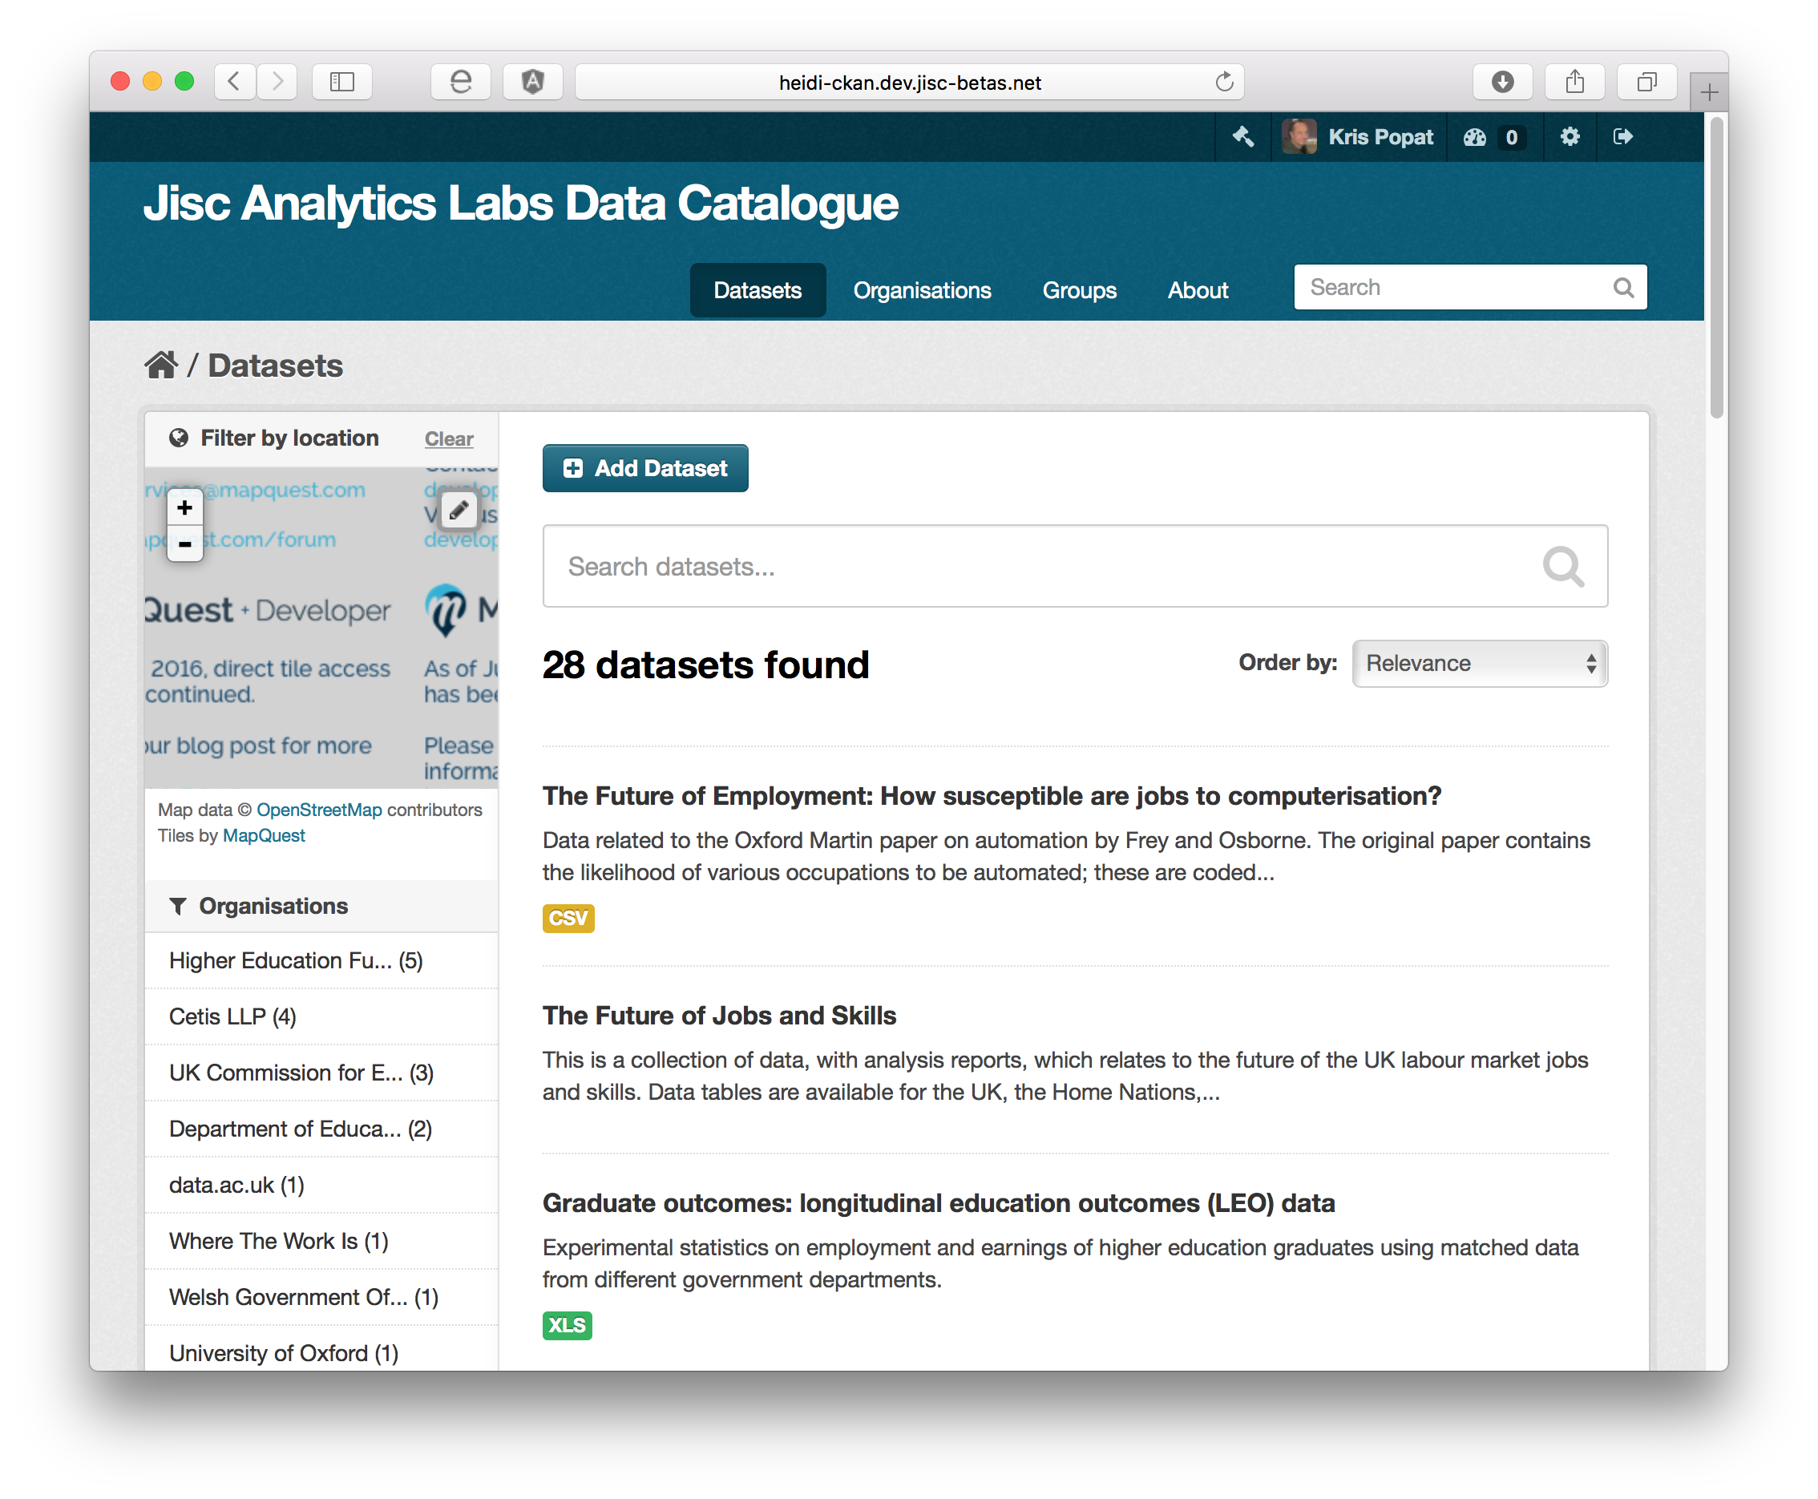
The Data Catalogue
Features include:
  Search – full text search on all fields
  Groupings - showing which teams used the data
  Tags - designed around Analytics Labs requirements
  Organisations – showing where data originated

Slide 54
What is the data catalogue?
A collection of links and information about publicly available datasets.
Information about previously used HESA data orders
This catalogue is publicly available
It can be found at http://bit.ly/bi-data-catalogue-2
We add to it with each cycle of the project
Intended to be a useful resource for the sector

Slide 55

Q & A
Notes:
We’d be happy to try and answer any questions. Anything we can’t answer directly today we’ll take back to project colleagues and come back to you.

Slide 56
Reference / further information

Slide 57
Analytics Labs Digital Badge
Notes:
Myles

Slide 58
Participating in agile development
Indicators | Evidence
Understanding requirements | User stories evident in final visualisations
Working collaboratively | Working effectively in teams or pairs Contributing to weekly scrums
Working iteratively | Contributing to sprint planning including backlog and retrospective Contributing to weekly scrums

Slide 59
Visualising data
Indicators | Evidence
Using data visualisation tools | Visualising data using Tableau or Power BI
Building interactive dashboards | Creating an interactive dashboard using Tableau or Power BI
Demonstrating good practice | Consideration of best practice evident in final visualisations

Slide 60
Transforming data
Indicators | Evidence
Using data transformation tools | Manipulating data using Alteryx or Pentaho
Cleaning datasets | Preparing data for visualisation using Alteryx or Pentaho
Combining datasets | Joining datasets using Alteryx or Pentaho Blending data using Tableau

Slide 61
Digital collaboration
Indicators | Evidence
Working in a remote team | Collaborating on projects using Trello or Basecamp
Real-time collaboration | Communicating using audio/visual technology and instant messaging
Group presentation | Collaborating on a PowerPoint presentation for the end-of-cycle showcase Screen-capturing a dashboards walkthrough video

Slide 62
Understanding policy and the data landscape
Indicators | Evidence
Understanding government policy | Understanding of policy evident in sprint planning
Identifying pressing sector issues | Understanding of issues evident in sprint planning
Knowledge of the data landscape | Identifying datasets which address user stories Understanding context and reliability of datasets

Slide 63
Overall Number of Datasets Considered
29
Data Sources
57
Unique Datasets
27
Teams

Slide 64

Where does the data come from?
Datasets came from 9 private sector organisations and 20 public sector organisations.
The most popular sources of data were HESA and HEFCE

Slide 65
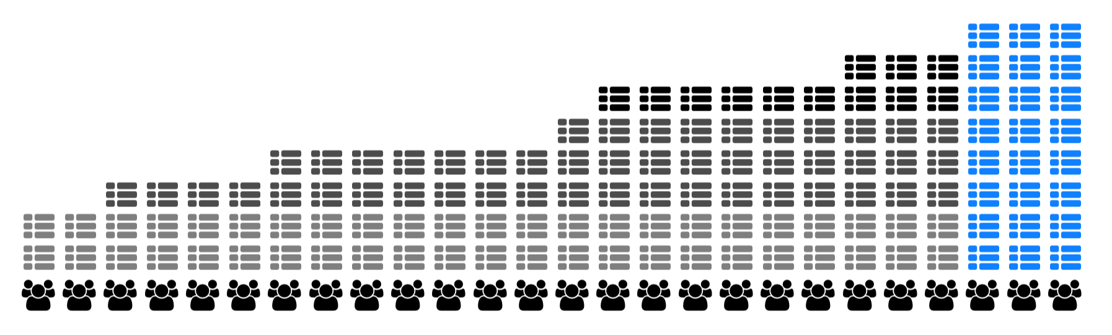
How many data sources do teams use?
The average number of datasets used by a team was 5.
The largest number of datasets used by a team was 8.

Slide 66
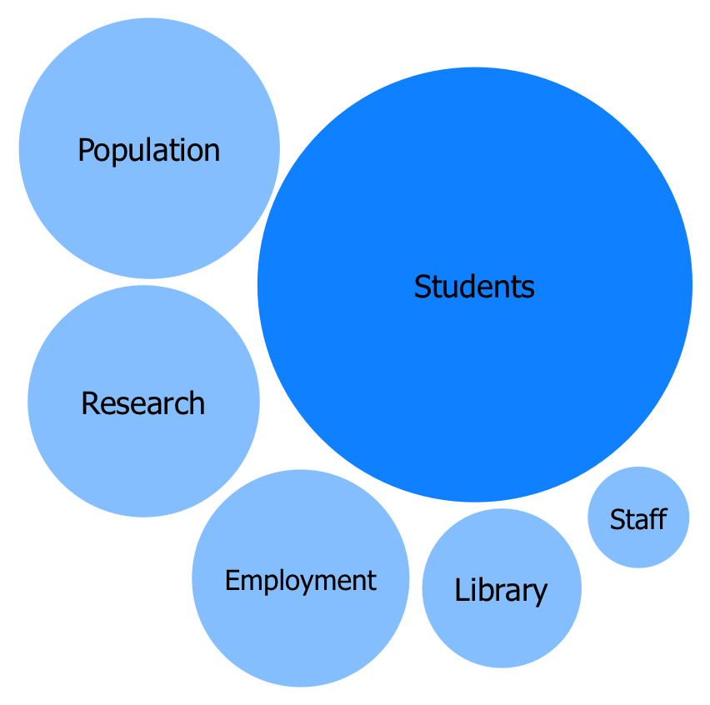
Popular Data Topics
The most popular types of data with teams were those concerning students, population demographics, research, employment and graduate outcomes.
A small number of teams worked with library, staff, estates and finance data.
The least used datasets were those concerned with BCI and apprenticeships.

Slide 67

Domestic verses international data
52 of the data sources used were from the UK.
Only 3 data sources were from the EU, and only 2 were international.
Some teams also used datasets specific to Wales and Scotland.

Slide 68
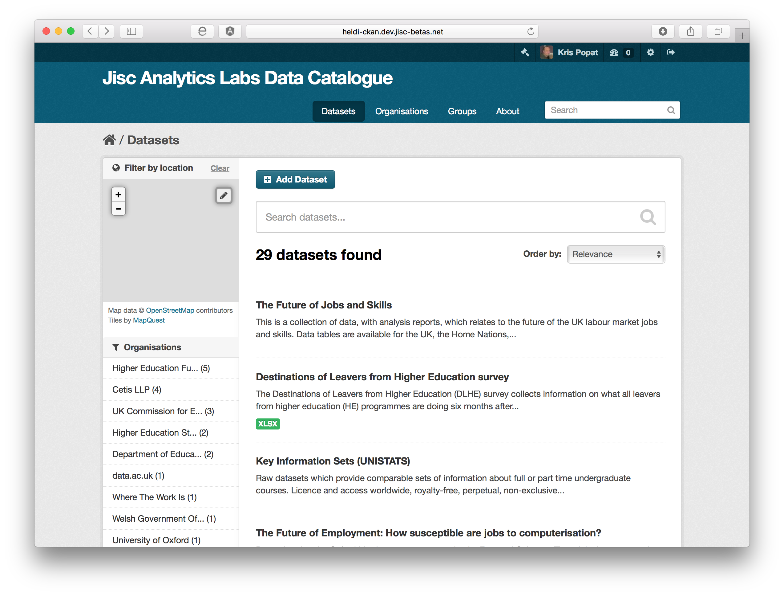
Data catalogue
Contains links to:
Public Datasets
Linking Datasets
bit.ly/bi-data-catalogue-2
Notes:
Kris to adjust slide
bit.ly/bi-data-catalogue

